Slide 1
EGB1201 – JAVA PROGRAMMING
PROJECT REVIEW-0
DEPARTMENT OF ELECTRICALAND ELECTRONICS ENGINEERING
Academic Year: 2025 – 2026 (Odd Semester)
Register Number : 927624BEE057
Name : LIBIKA S
Year : II
Semester : III
Date : 29.08.2025

Slide 2
Title of the Project
BLOOD DONATION MANAGEMENT SYSTEM

Slide 3
Abstract
The Blood Donation Management System is a software tool to manage donor and recipient details, maintain blood stock, and quickly match blood groups. It reduces manual work, saves time in emergencies, and ensures the timely availability of blood through an efficient and user-friendly platform.

Slide 4
Objectives
1. To maintain accurate records of donors, recipients, and blood stock.
2. To ensure quick and reliable blood group matching during emergencies.
3. To reduce manual work and save time through automation.
4. To provide a user-friendly system for managing blood donation activities.
5. To make blood donation and distribution more efficient and accessible.

Slide 5
Existing
Most blood donation processes are handled manually using paper records.
Donor and recipient details are stored in registers or spreadsheets, making it hard to search quickly.
During emergencies, finding a matching blood group becomes time-consuming.
Manual records may lead to errors, duplication, or data loss.
Communication between donors, recipients, and blood banks is often slow and inefficient.

Slide 6
Proposed Architecture
Presentation Layer (UI): Web/desktop interface for donors, recipients, and admin.
Controller Layer: Handles user requests (e.g., donor registration, blood request).
Service Layer: Business logic like donor eligibility, matching blood groups, updating
stock.
Repository/DAO Layer: Database operations using JDBC/JPA/Hibernate.
Database: Tables for Donor, Recipient, BloodBank, BloodStock, Donation, User.

Slide 7
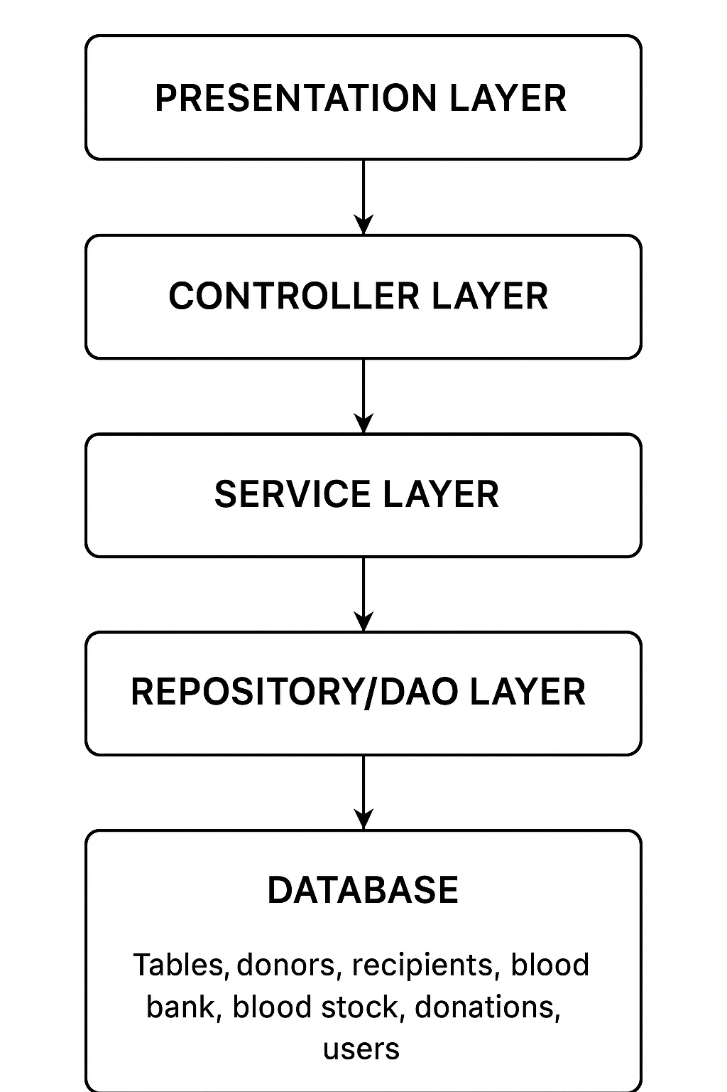
Block Diagram

Slide 8
Thank You

